Slide 1
Team name- Error 404
college- veer Surendra sai
university of technology, burla

Slide 2
TEAM NAME : ERROR 404
TEAM MEMBERS : PUNYASLOK SWAIN
ARYAN PATEL
CHINMAYA PRADHAN
SAHARSH PANDA
COLLEGE- : VEER SURENDRA SAI
UNIVERSITY OF TECHNOLOGY

Slide 3
CONTENTS
IDEAS
FEATURES
TECH STACK
DEPENDENCIES
IMPLEMENTATION STRATEGY
CONCLUSION

Slide 4
IDEAS
We will make an WEB APPLICATION based on real time management where every person will have their own ID.
It would make a database of the people we meet so that if we or anyone have corona virus then the person he meets can be quarantined.
It would alarm us to leave if we are at a crowded place and notify to the nearest police station about the same as well.
It would also provide the corona affected area around us so that we wont go there.

Slide 5
FEATURES
FEATURES

Slide 6
TECH STACK
A profile of every user would be made using ADHAR CARD and a special IP ADDRESS would be made.
By using GPS technology real time location will be uploaded to the server.
It would create the location history and person whom he meets or came in contact with using data base technology.
It would alarm us to leave if more than 5 people using mobile’s alarm system.

Slide 7
DEPENDENCIES
The APP development depends upon JAVACSRIPT and HTML.
The real time management system depends upon the GPS quality of the mobile.
The database management depends upon the data input method of device.
The notification system depends upon the device’s effective alarming system.

Slide 8
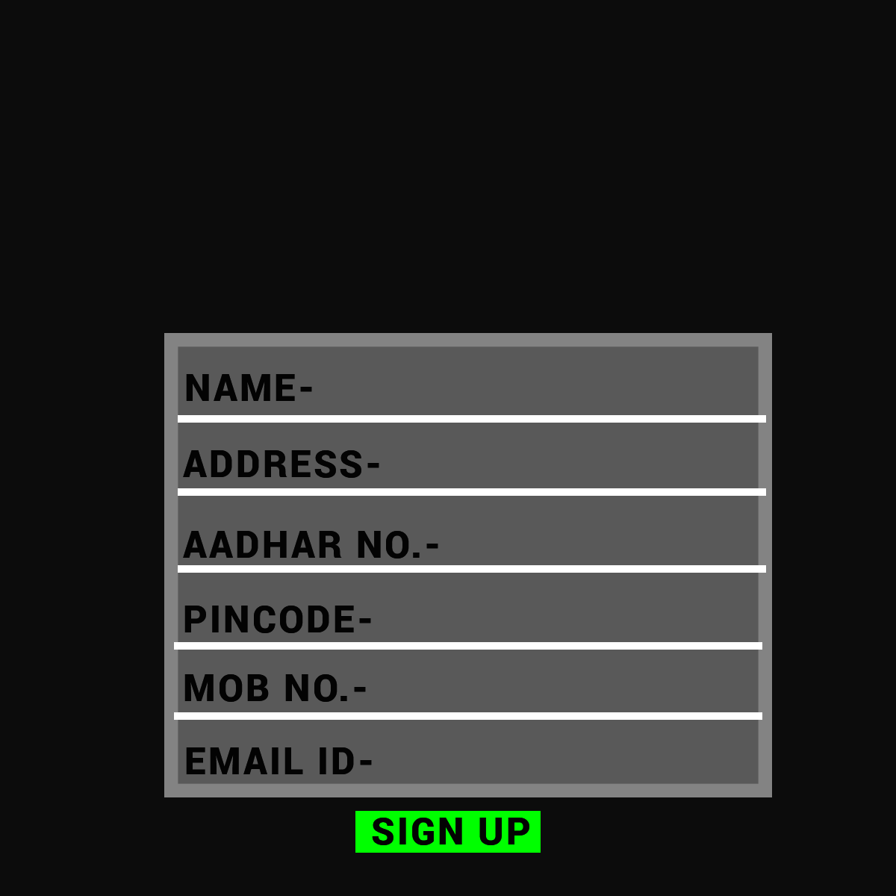
IMPLEMENTATION STRATEGY
This app will be available in play store where users can download. This app will be logged in by using Aadhar number and mobile number

Slide 9
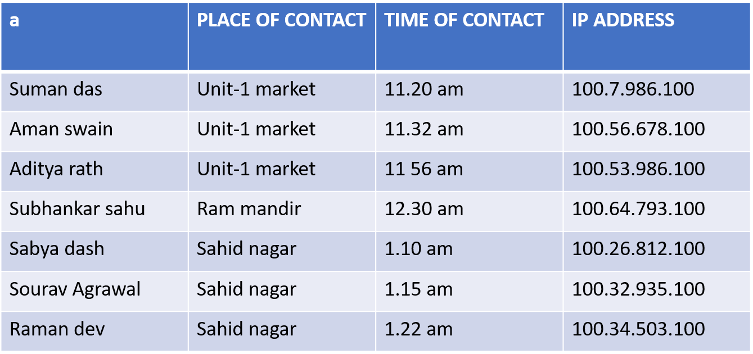
When the person would go to the market then this app will store and create a database of all the people he meets. The database would contain the person’s name, IP ADDRESS, place of visit, time .
If the person if found positive then the person with whom he meet could be found and be quarantined.
Ex.

Slide 10
It will save the location of the person last visit so as to sanitize it and lock it down.
Ex.
PLACE OF VISIT | DATE OF VISIT
KIRBA | 14/03/2020
KALIA | 16/03/2020
VSSUT COLLEGE | 17/03/2020
VIMSAR | 17/03/2020
RIGHT DYKE | 19/03/2020

Slide 11
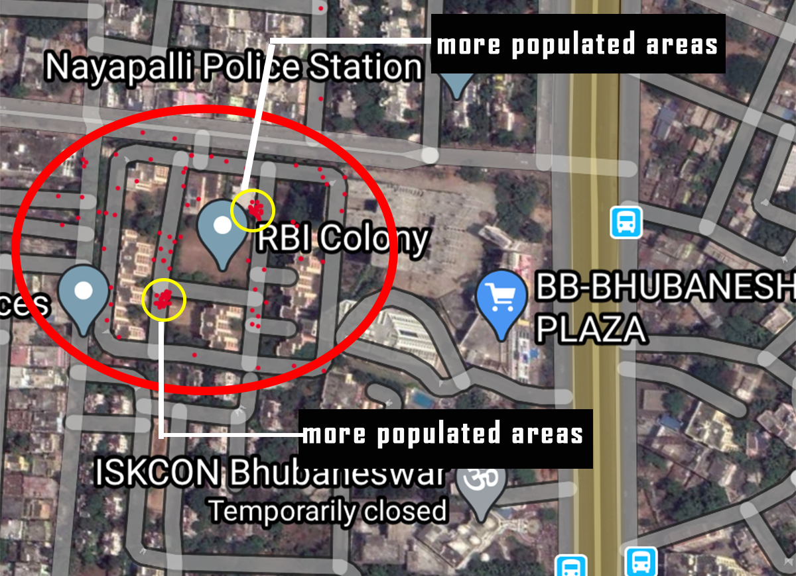
Using this application police can also see the real time crowd using GPS technology and can remove the unnecessary crowd.

Slide 12
If more than 5 people gather at any place then all their cell phones start vibrating and a notification will automatically send to owner.

Slide 13
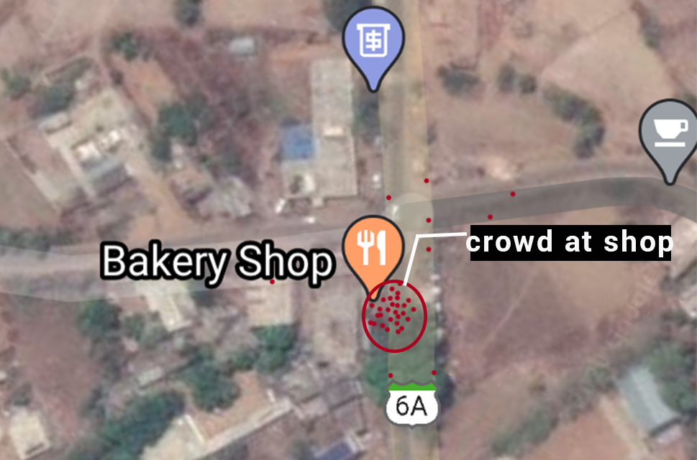
Using this application the user can see the real time crowd of shops and he/she can go to the shop when the shop is not much crowded.

Slide 14
FUTURE WORK PLANS
We can integrate it to Bluetooth technology for it vast expansion.
It is not only limited to Corona virus but for many others communicable pandemic as well.
There will be separate databases for different area stored and observed by regional officers.
It is based on Machine Learning technology which is evergrowing, helpful in expanding the technology.
We can add Doctors conference facility which enables video calling of local with the local doctor in a specific time.

Slide 15
REWARD SCHEME
As every person have to download the app, there is a great possibility they might end up not doing it.
There is a reward scheme that would attract them to download it.
This scheme gives them some reward when tey download it and refer it.

Slide 16
CONCLUSION
We tried to build an APP to overcome challenges faced during this pandemic. The Crowd Management is a huge challenge as the only way the virus can spread is via social interaction. If we manage it then we can stop its effect and growth. Our way was to aware everyone about the crowd and can trace the person that may have the chance of having it.

Slide 17
THANK YOU

